Slide 1
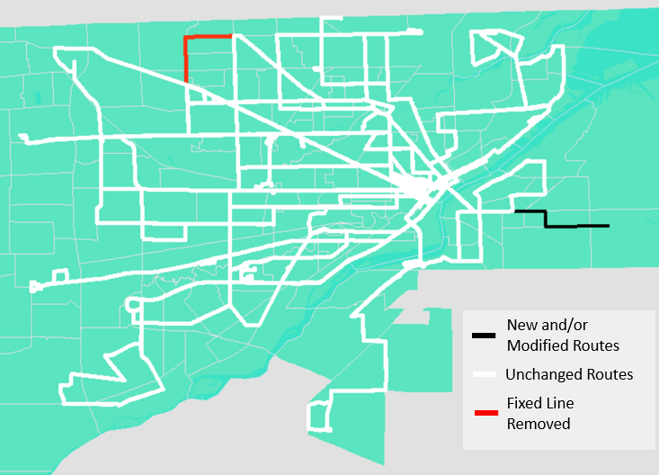
Winter 2024
Proposed Fixed Line Service Changes
Route 2 Modifications
Weekend Frequency Increase for Route 52
Removal of Route 51
Notes:
Today we will be reviewing the proposed major service changes for the Winter 2024 assignment. Changes include...

Slide 2
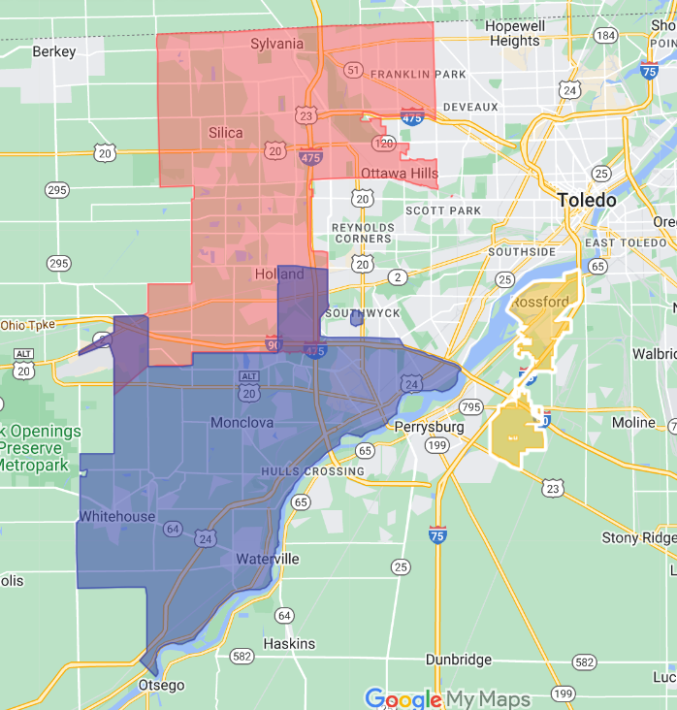
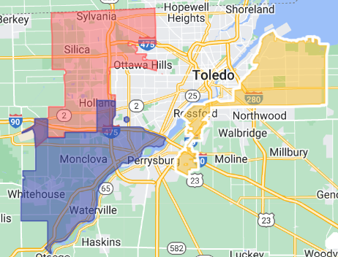
Flex Service Area Change
Proposed January 2024
Current
East Zone
Rossford Zone
Notes:
In addition to the changes to the fixed line, the Flex service area will expand as well. What is currently the Rossford Zone will expand to include the Oregon jurisdiction and some of East Toledo. Once in place this will be referred to as the East Zone.

Slide 3
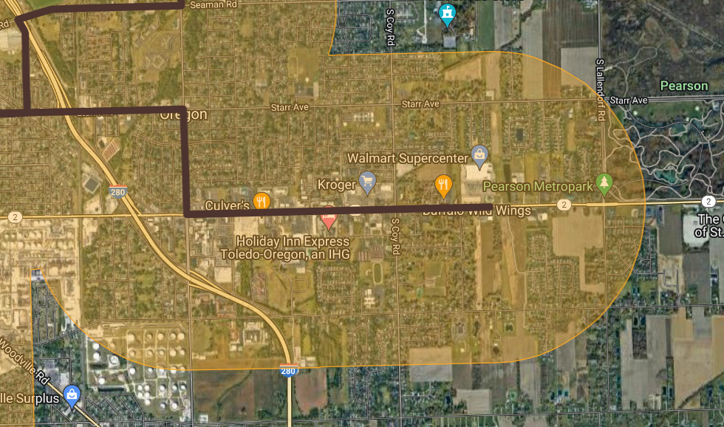
Route 2 Extension
Starr
Wheeling
Navarre
Existing Fixed Line
Route Extension
TARPS ¾ Mile Service Area
Notes:
The proposal for Route 2 has it extend along Starr, Wheeling, and Navarre in order to provide access to the major shopping centers including the Walmart Supercenter. This also extends the ¾ mile buffer service area for TARPS.

Slide 4
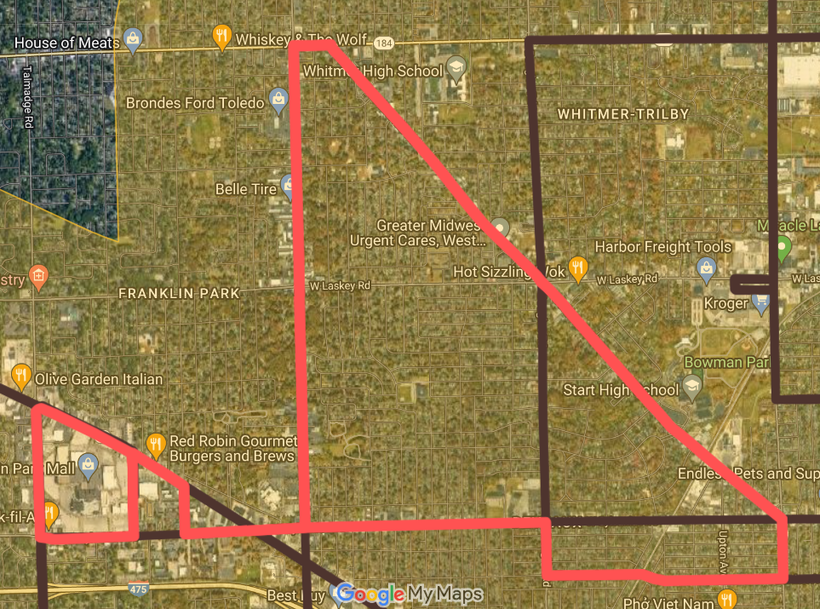
Route 52
Secor
Tremainsville
Monroe
Sylvania
Winter 2024 Fixed Line
Route 52
TARPS ¾ Mile Service Area
Notes:
Route 52 will not change shape. Route 52 provides a circular service around Tremainsville, Secor, Sylvania, and Franklin Park Mall. In conjunction with balancing service scheduling and to improve weekend service, the frequency will be doubled.

Slide 5
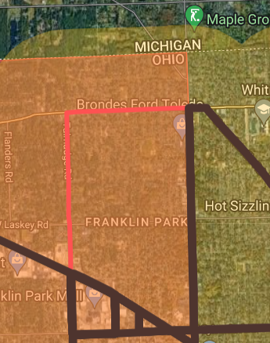
Route 51 Removal
Alexis
Talmadge
Existing Fixed Line
Route Removal
TARPS ¾ Mile Service Area
Notes:
The removal of Route 51 was part of the near term improvements proposed with TARTA NEXT last year. The removal will mean stops along Alexis and Talmadge north of Monroe will no longer have fixed route service. However, the TARPS ¾ mile buffer will NOT be reduced. The TARPS service area will be maintained for paratransit users.

Slide 6
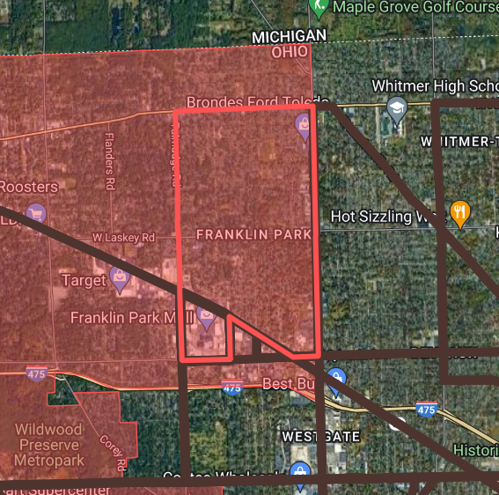
Alexis
Route 51 Alternative
Talmadge
Secor
Existing Fixed Line
Route Removal
Alternate Fixed Route
Flex NW Zone
Notes:
For those who still need service for the area, TARTA flex NW zone is still an option. Additionally TARTA fixed line service will still be available from other routes on Secor, Monroe, and around Franklin Park Mall.

Slide 7
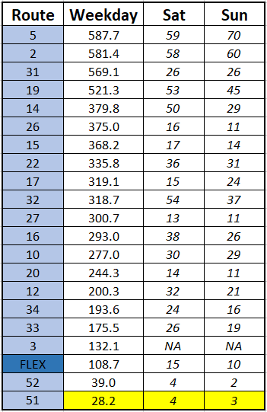
Average Ridership Counts
Notes:
The primary reason behind the removal of Route 51 is because it has been the lowest performing route.

Slide 8
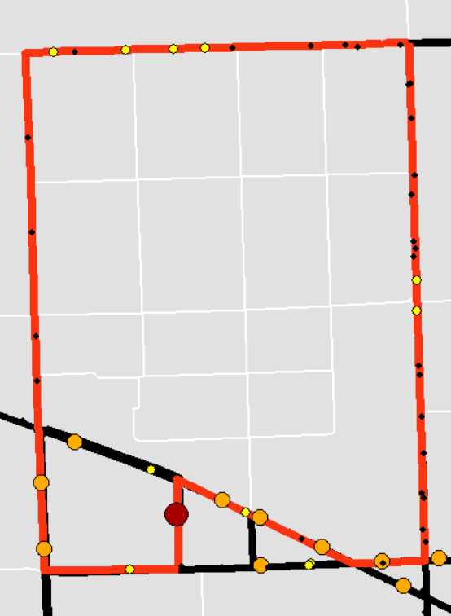
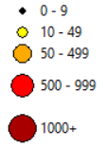
Alexis
Route 51 Ridership Sample
March 26 – April 8
Ridership sample size along Route 51 = 2245
Alexis and Talmadge north of Monroe accounted for 92 boardings in total during the sample period ( <7 per day on average)
61% of the area ridership occurs at the Franklin Park Mall stop
Total Boarding
Secor
Talmadge
Fixed Line
Route 51
Notes:
Read slide

Slide 9
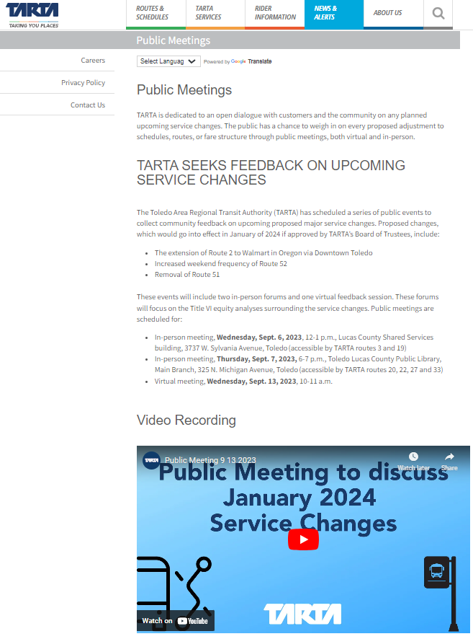
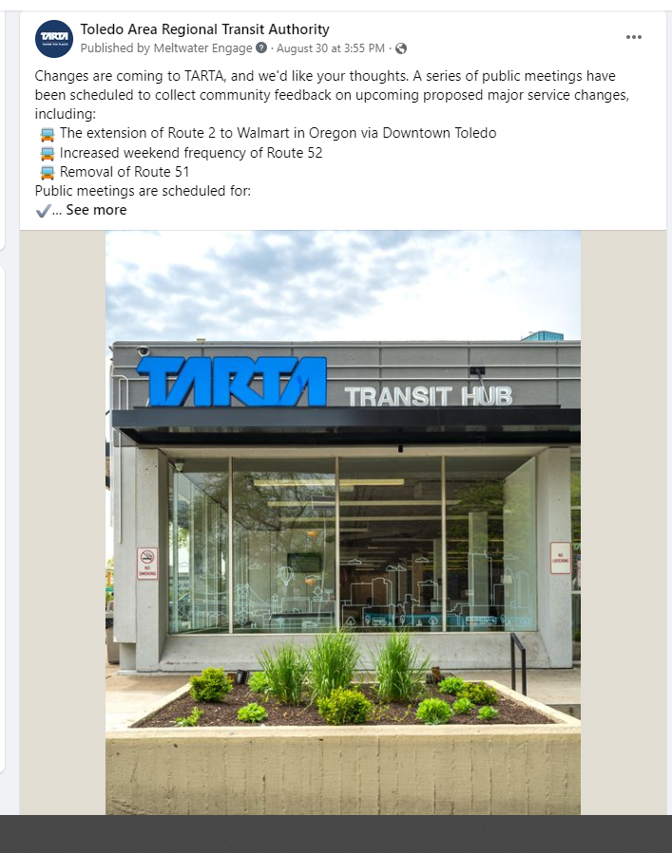
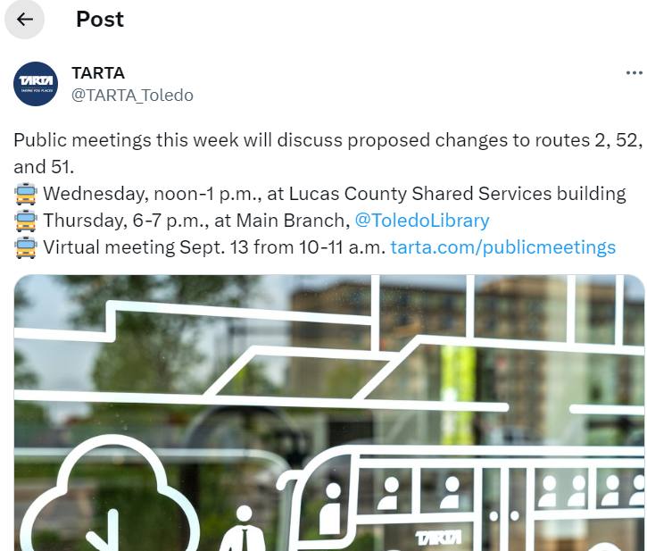
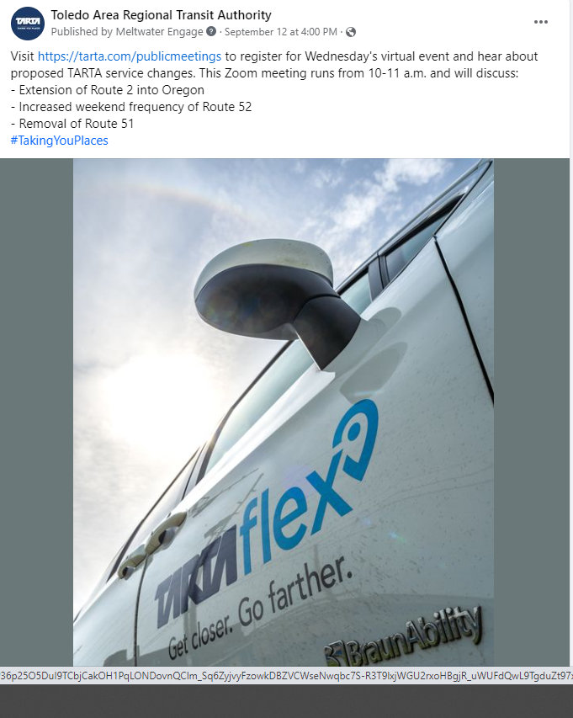
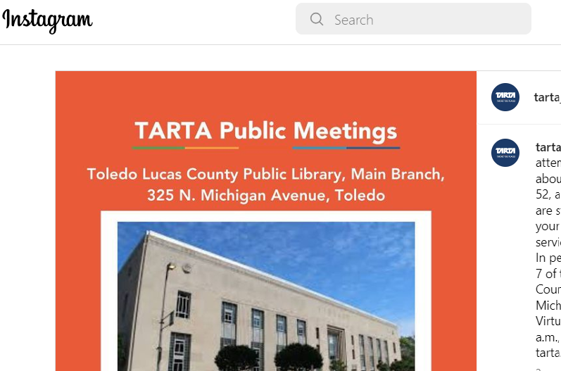
Public Outreach / Feedback
Notes:
There were 3 public engagement meetings set, 2 in person and 1 virtual. Notices were posted at the hub, on the TARTA website and social media, in the area newspapers, and invites were also sent to rider advocate groups like ABLE, the Ability Center, and the Area Office on Aging. There were 5 Facebook posts with a total of 19 comments from the public, 36 likes, 24 shares. Twitter (X) had had 5 posts with a total of 5 likes and 3 shares. Instagram had 4 posts with a total of 40 likes.
No emails were received regarding the service changes.
The TARTA website page on Public Meetings had 146 unique views during the public comment period. This is close to the median for the TARTA website during that time.
Public turnout for the engagement meetings were 5 for September 6, 5 for September 7, and 3 for the September 13th virtual meeting.
Facebook comments expressed confusion and frustration regarding the inclusion of the Oregon extension as part of Route 2, as opposed to it being a standalone route or connected to an east Toledo Route like 12 or 14. During the public meetings, inquiries arose concerning the consequences of eliminating Route 51 for ADA riders and seeking further clarification on the specifics of the Flex microtransit service as an alternative choice.

Slide 10

Questions?
Notes:
Additional details about the service change as well as the public comment record are included in the TITLE VI WINTER 2024 report. At this time can I help answer any questions?

